Slide 1
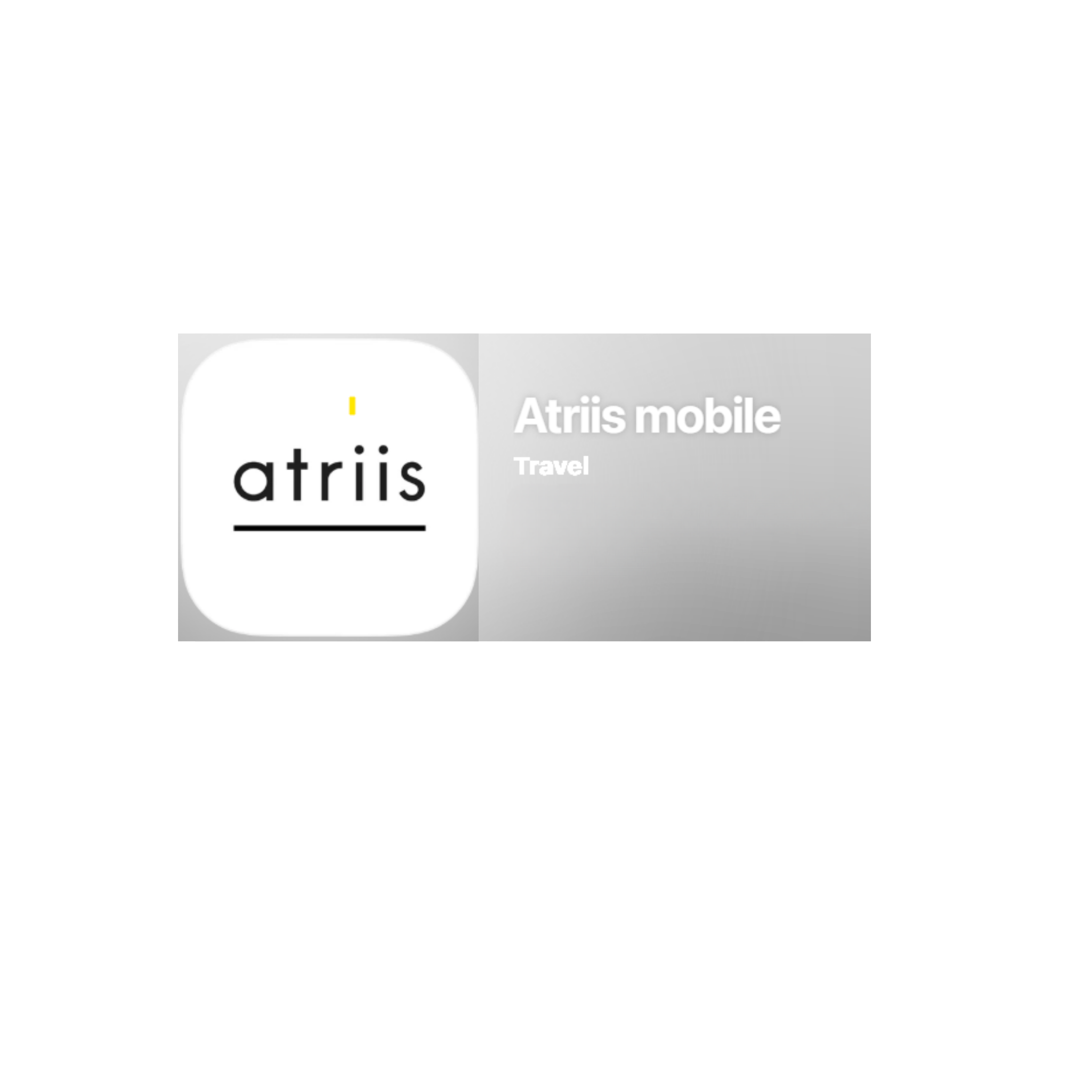


ATRIIS
Online User Guide
By Shelley Reeves
Version July 2026

Slide 2
ATRIIS - Contents
Slide 2 – Contents
Slide 3 – Logging to Atriis
Slide 4 – User Profile
Slide 5 & 6 – Booking a New Trip
Slide 7 - Trip Status
Slide 8 - Complete Trip Search
Slide 9 - Adding Hold Baggage
Slide 10 -12- Search by Schedule
Slide 13– check out with approval
Slide 14 – Approval guidelines
Slide 15– Redirect for approval
Slide 16 – Pre-booking approval (instant purchase)
Slide 17 – Action Required email
Slide 18 – How to finalize a booking once it's been approved
Slide 19– Trip Overview-Booking Confirmed
Slide 20 – Request Assistance- Chat Functionality
Slide 21 – Email Quotes
Slide 22-24 – Hotels
Slide 25 – Car Hire
Slide 26 -28- Additional Products
Slide 29- Booking Premier Inn Hotels
Slide 30- Mobile App
Slide 31 – Best Practice
Slide 32- Top Tip- Keep everything under one trip number

Slide 3
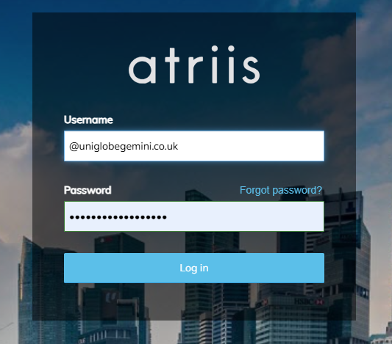
Logging to ATRIIS
URL is https://www.gtp-marketplace.com/
For best results use web browsers - Chrome, Firefox or Edge.
We do not recommend Internet Explorer as this is not supported.
Online Support – support@uniglobegemini.co.uk
Offline Support – res@uniglobegemini.co.uk
Login – Your login is your company email address. You should have been sent login details. Please check your spam folders.
If you haven’t received your login, click on ‘Forgot password?’.
If you do not receive the email check with your administrator or contact support@uniglobegemini.co.uk.

Slide 4
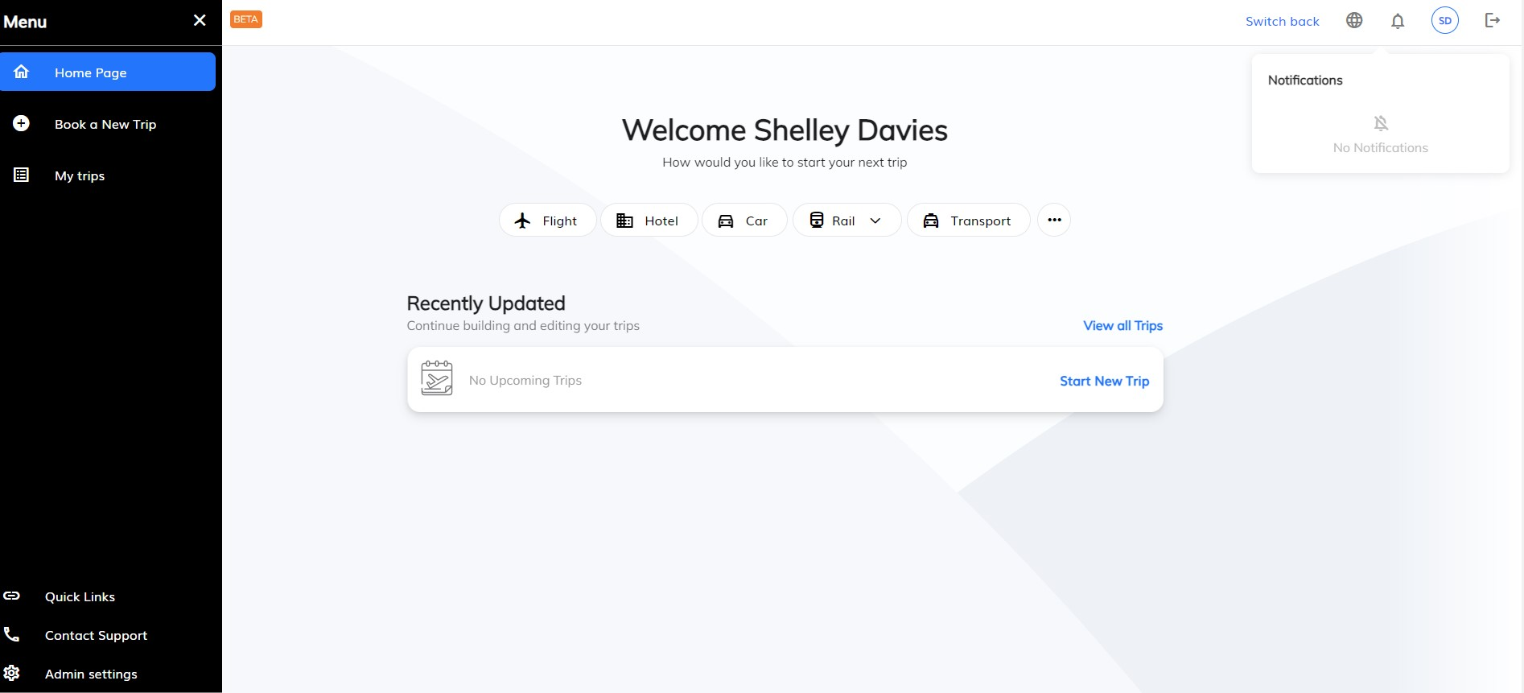


User Profile Settings
The first time you login to the online booking tool, you MUST check your User Profile is correct.
Update your name (must be as per your passport ID used for travelling), add any important information like passport data and loyalty schemes. Check your Cost Centre / Department or any data (if required) is correct.
You do not need to add ‘Form of Payment’ Information.
SAVE any changes.
Back Up Approver
Each approver can have a backup. This must be enabled by admin users.
To designate the backup approver, open the User menu and go to the main approver profile. You can then add the backup approver.
Out of Office
Approvers can delegate their approval to another person while out of the office. The setting is in their profile, and will be triggered for new bookings

Slide 5
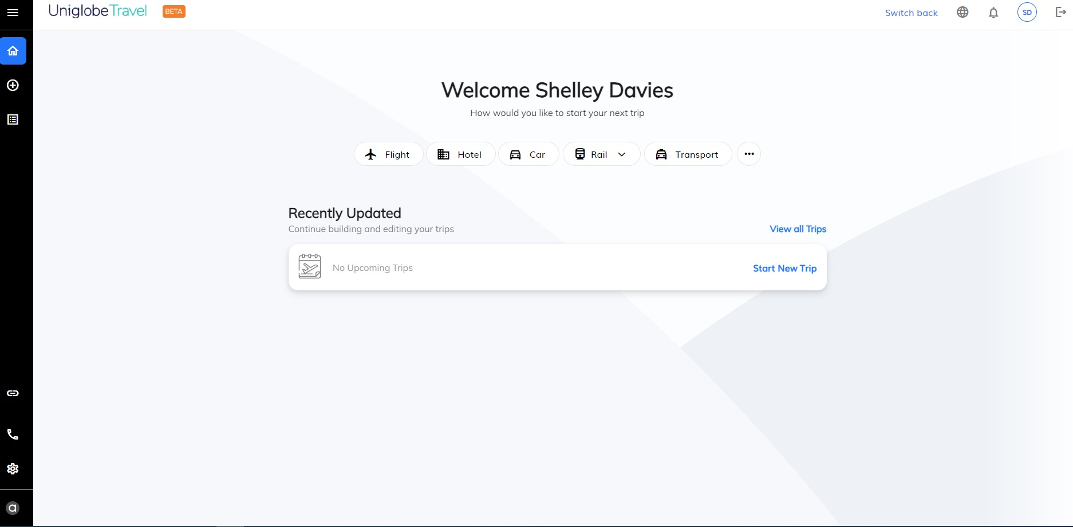
Booking a New Trip
(Travel Arranger Settings)
2. To book a trip you can select from the options “Flight” , “Hotel”, “Car”, “Rail”, “Transport” . You can look at more than one booking at a time as this opens a new tab each time.
1. Click on your name edit your personal information and preferences this includes passports, frequent flyer cards etc
3. Find a booking

Slide 6
Booking a New Trip
(Traveler Settings)
2. To book a trip you can select any of the ‘Book a New Trip’ buttons.
1. Click on your initials to edit your personal information and preferences this includes passports, frequent flyer cards etc
Quick links will send you to the online booking tool FAQ’S Page.
Uniglobe Support contact information

Slide 7
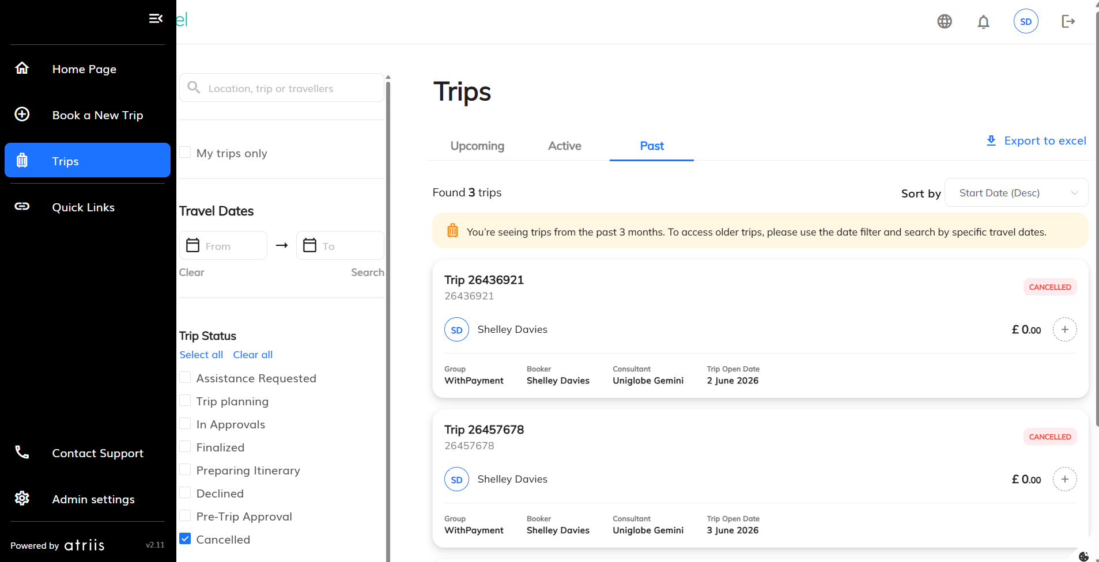
Trip Status – View in “Trips”
“Trips” will show the traveler or travel booker a summary of trips and the current stage of each trip.
Travelers or bookers can check to see to if trips have been processed or if your company has an approval system in place you can see if the trip has been approved or is waiting for approval. It is IMPORTANT to check the status of your trip. A trip is only confirmed when it shows as FINALIZED.
Trip Planning – Trips with quotes PRIOR to check out
Pending Booking – Added to the cart but not placed on hold/booked/confirmed.
Assistance requested – Trips where Assistance Requested was sent to the agent.
Cancelled – Quote or Trip cancelled by User.
Expired – Quote Expired and need to be re booked and added to the cart again to purchase.
In Approvals – Trip in Approval process
Preparing Itinerary – Trip approved and sent to ticketing.
Finalized – Trip approved and issued

Slide 8
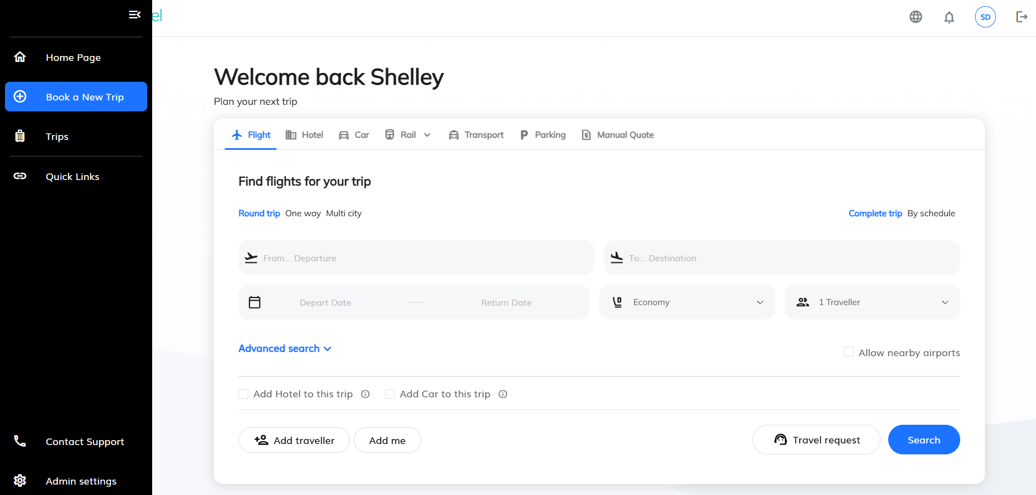
Book a New Trip
The 'Add Hotels / “Add Car” to this trip' checkbox will enable you to search for hotels/ cars while we search for flights, saving a few precious minutes.
Search for all products at once
Add Traveler(s) now or later
Add me if you are the person travelling.
Do you need help when booking?
‘Contact Support’. Will provide you with all the numbers to call for assistance.

Slide 9
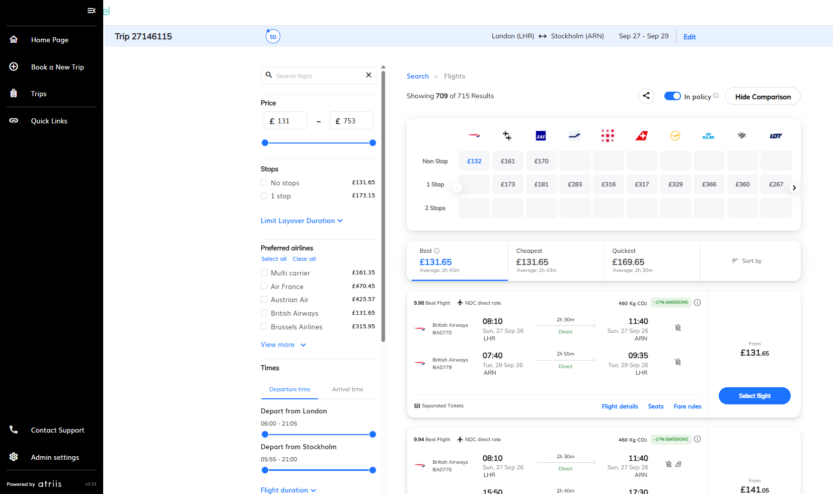
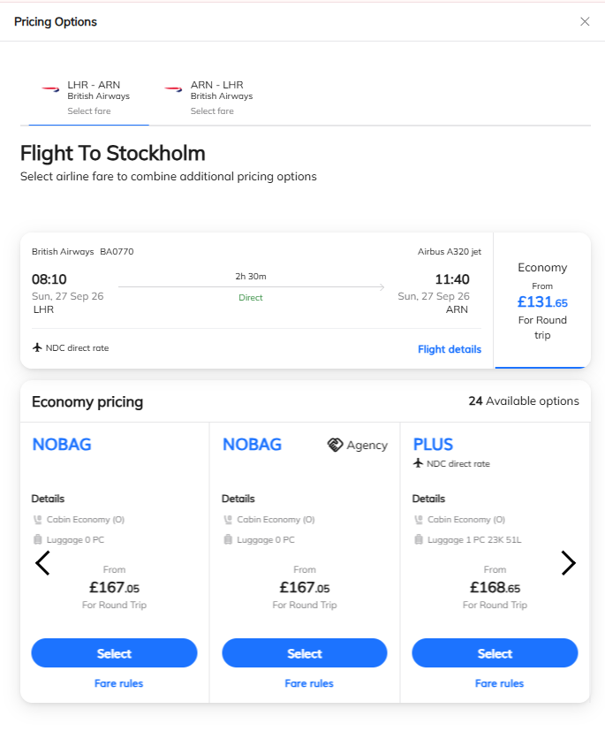
Complete Trip Search
Fare Matrix (click on the airline to filter)
To book a flight ‘Select flight’
A pop-up pricing options box will appear select the fare from the options. “NOBAG” for no CHECK-IN luggage or “PLUS” to include 1piece-23kg of check-in luggage etc. Then “Add to trip”
Use filters to narrow your
search results
Lowest fares are shown which often exclude hold baggage.
Expand to full flight details, select seats and view fare rules.

Slide 10
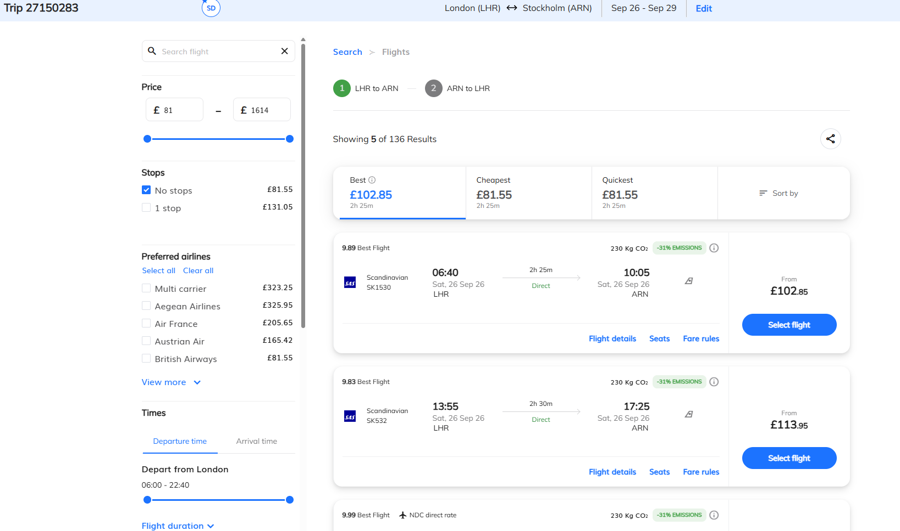
Search by Schedule
This search is timetable view.
First select your outbound flight then select your inbound flight.
The system will then work out the best prices for your flight combination.
Use filters to
narrow your
search results
Select your flight

Slide 11
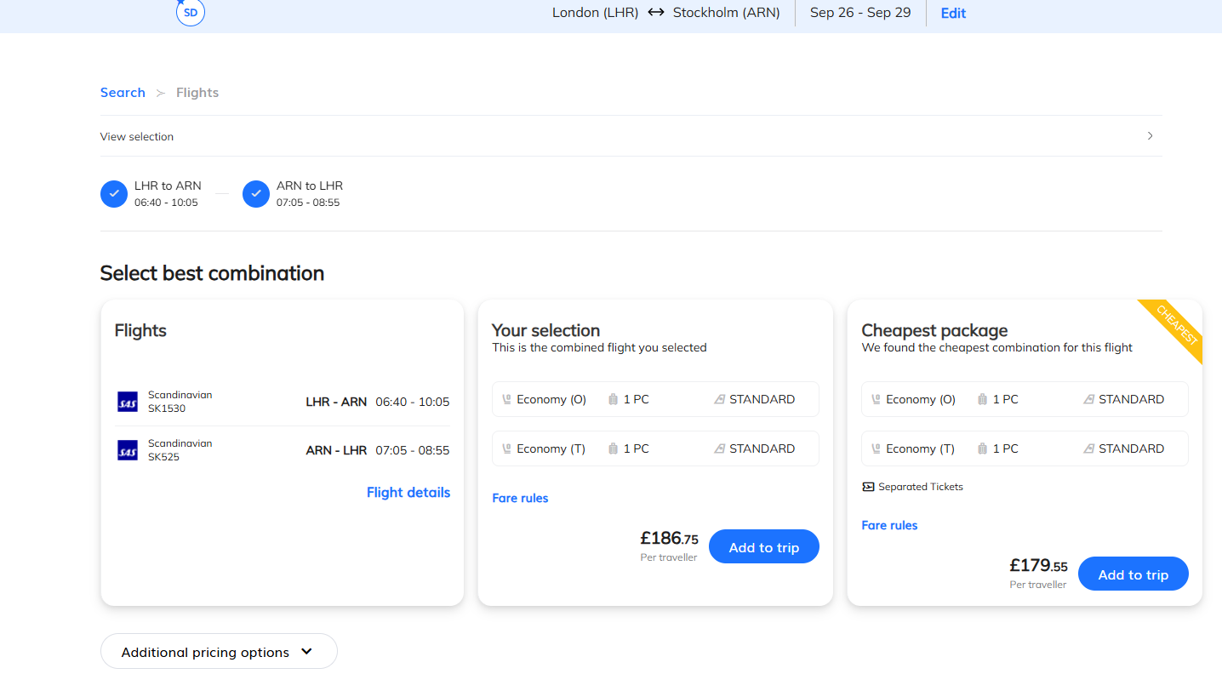
Review and Select
Select the preferred fare combination.

Slide 12

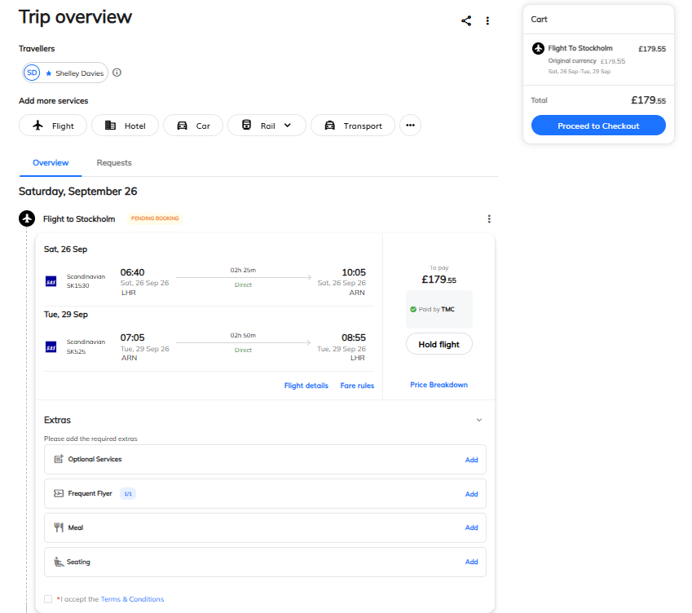

Completing your booking
To CONFIRM your booking ‘Proceed to Checkout’.
Cancel and delete items from your basket.
Expand for full details
On this page you can select seats, meals and baggage for low cost airlines etc
Add more products to your shopping basket!
Accept the T&C’s

Slide 13
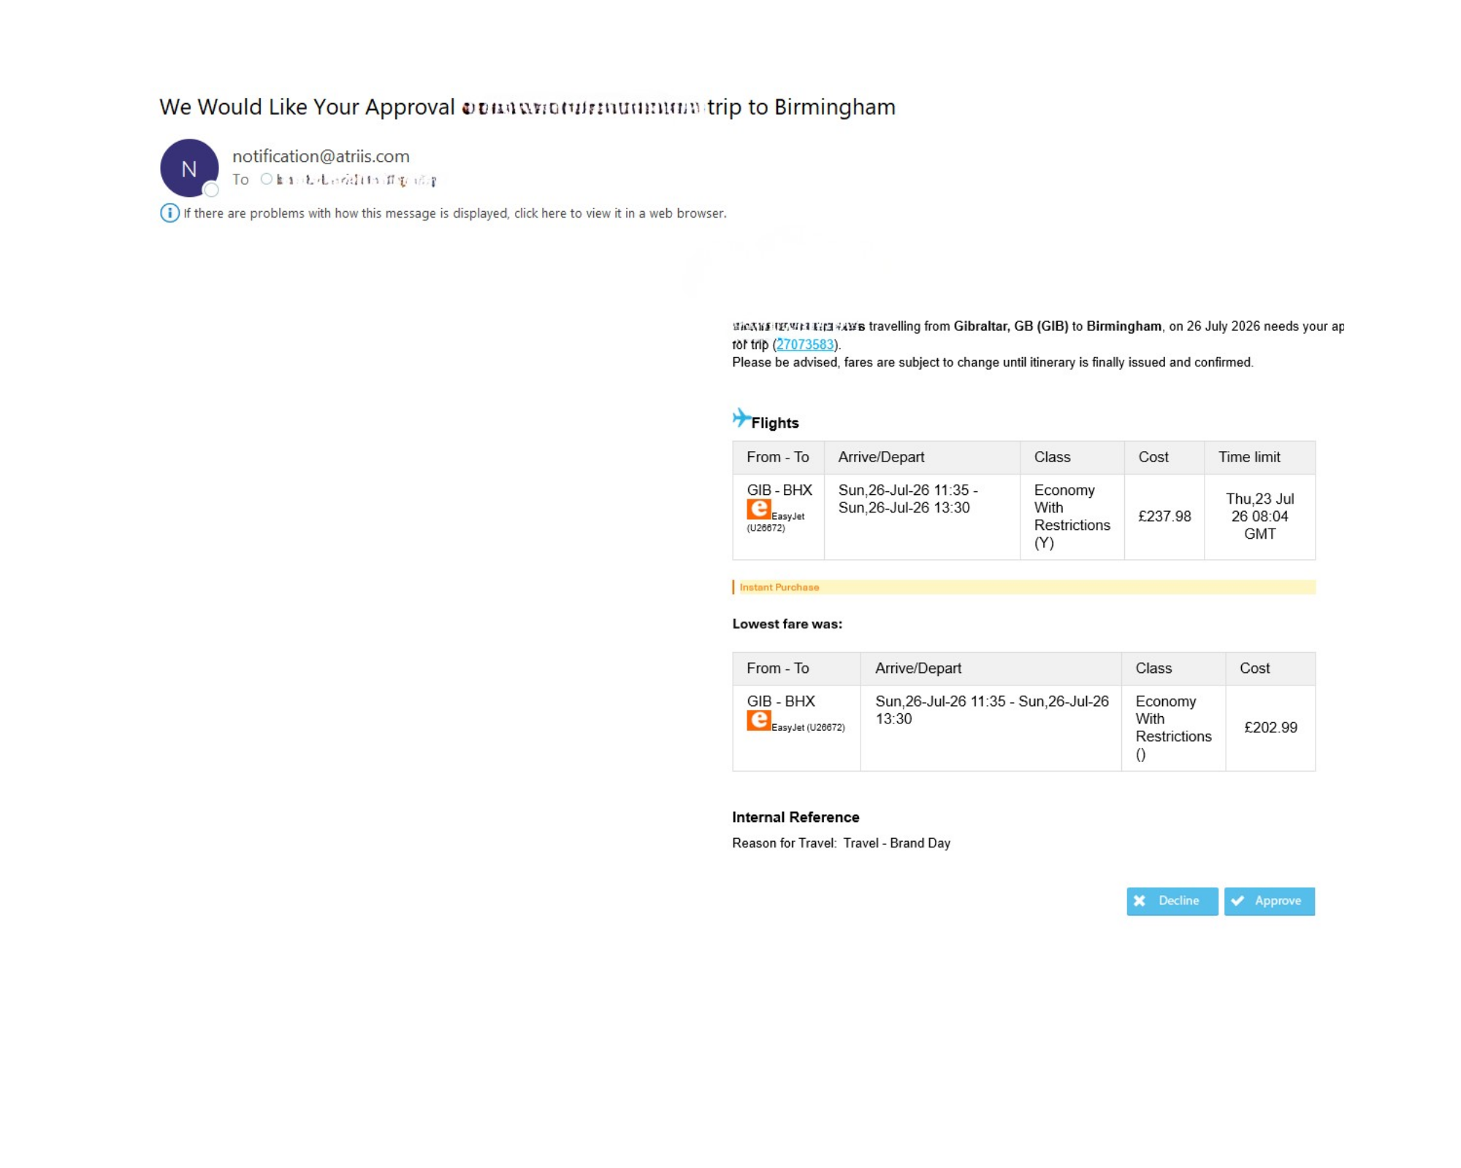
Check out
With Approval
EXAMPLE OF APPROVAL EMAIL
It’s the traveller's responsibility to ensure all bookings are approved by the line manager on the day the booking is made. If the booking is not approved, it will automatically cancel and we are not able to reinstate bookings once cancelled.
The line manager will need to approve or decline

Slide 14
Approval Guidelines
**Subject to company specification***
In the Trips tab go to Trip status here you can see if your trip is in approvals stage.
If you want to change your approver or resend, click on ‘Modify Approval’.
Your ‘Trip Approver’ is set in your user profile. ( Your initials at the top right-hand side)
It is the travelers’ responsibility to ensure your approver is available to approve travel.
The selected approver receives an e-mail from which they can approve.
An Action MUST be taken BEFORE the given Time limit or your booking will be cancelled.
Important:
Bookings could need action outside of office hours including Evenings, Weekends and Holidays.
The Approver MUST act on receipt of email regardless of time of day/day of the week.
The Requester must be satisfied the approver can approve within the time limit. If not they should select a different approver that can approver the booking.
The Approval Request Email MUST be Actioned By the Deadline it is NOT an option to delay
or Ignore.

Slide 15
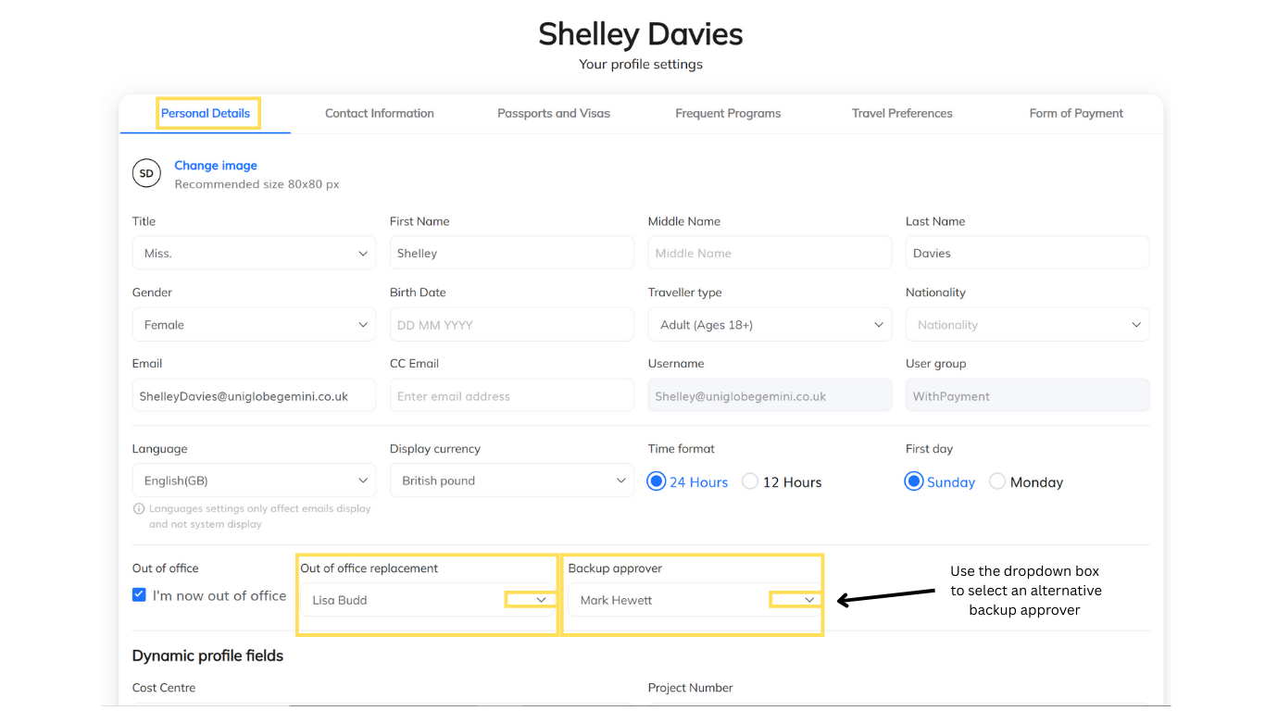
Redirect for Approval:
To redirect your trip for approval, follow these steps.
Log in to the online booking tool, and on the right-hand side will be a welcome and your name, this is your profile.
Click on your profile and a box will appear (My Profile).
Under 'Personal Details' you will see a box saying, 'out of office', check this box and then select / add the replacement approver.
And don't forget to save your changes.

Slide 16
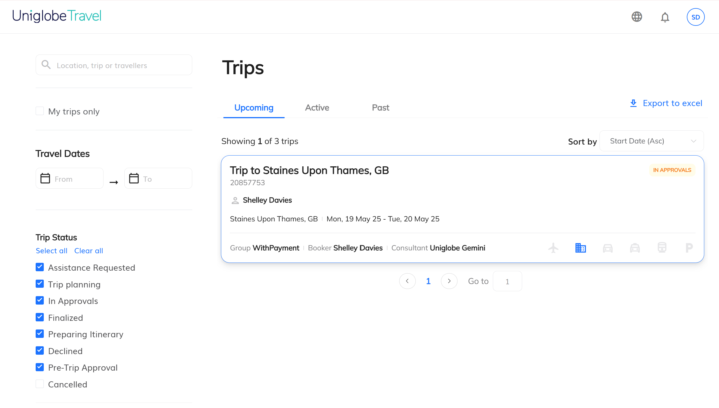
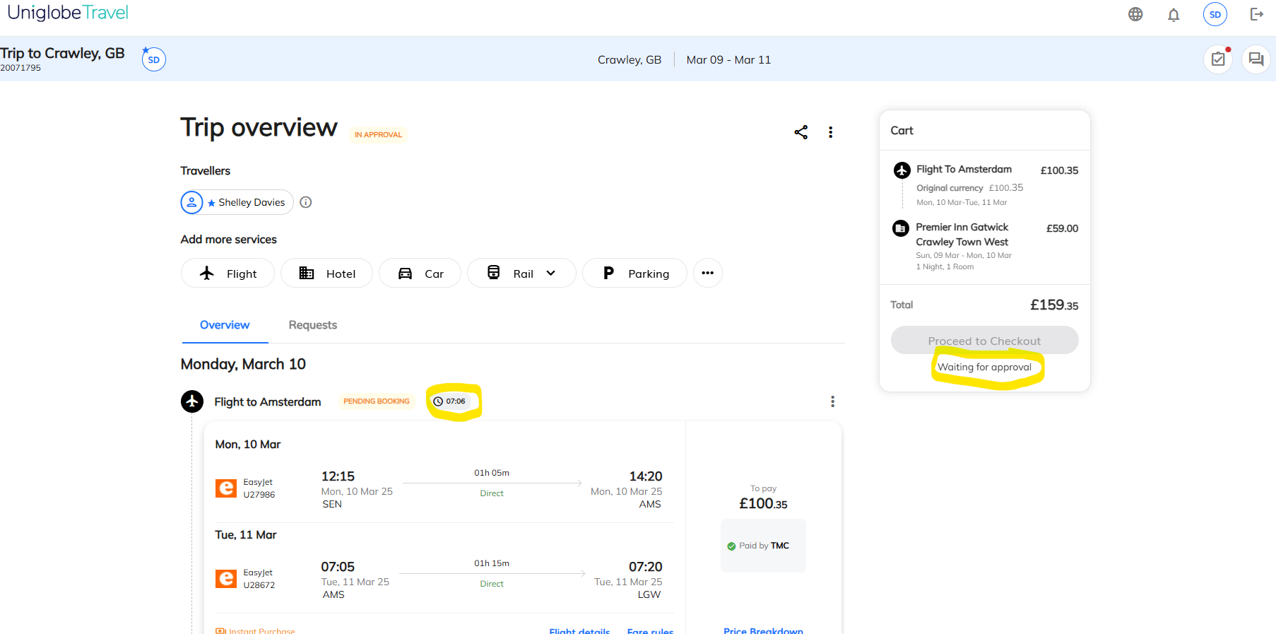
Pre-Booking Approval for Low cost & Instant purchase/non-refundable products. (this is company specific)
1. When a corporate user adds a low cost carrier / non- refundable hotel (like EasyJet) or other instant purchase/ non-refundable product to the cart, the trip will be sent for approval before we allow to purchase the flights / hotel.
At this point you have not booked any flights/hotels, you are just sending the amount of the trip (quote) for approval BEFORE booking the flights/hotels. This is because these are instant purchase items that can’t be ‘held’ and are liable for payment as soon as they are booked.
You add the trip to your basket, then send for approval
2. After having sent for approval, the user receives the below warning advising them that the trip has NOT been booked and needs to be approved.
3. The quote will stay as in approvals until it is approved.
Once approved, the online user will receive a notification to advise them that they can proceed with the booking. This is titled ‘Action Required’.

Slide 17
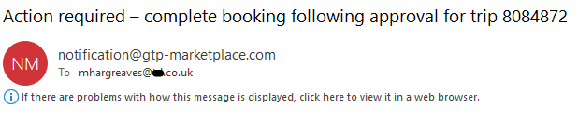
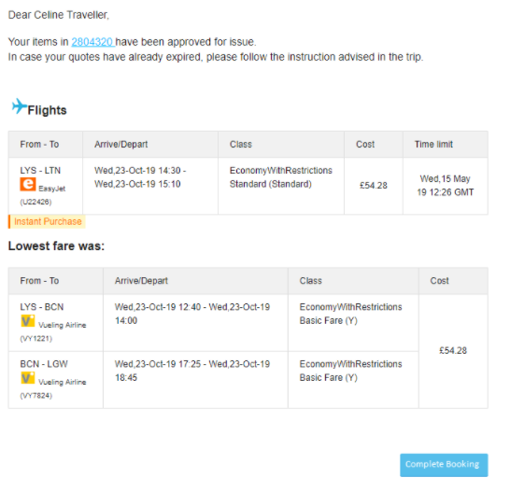
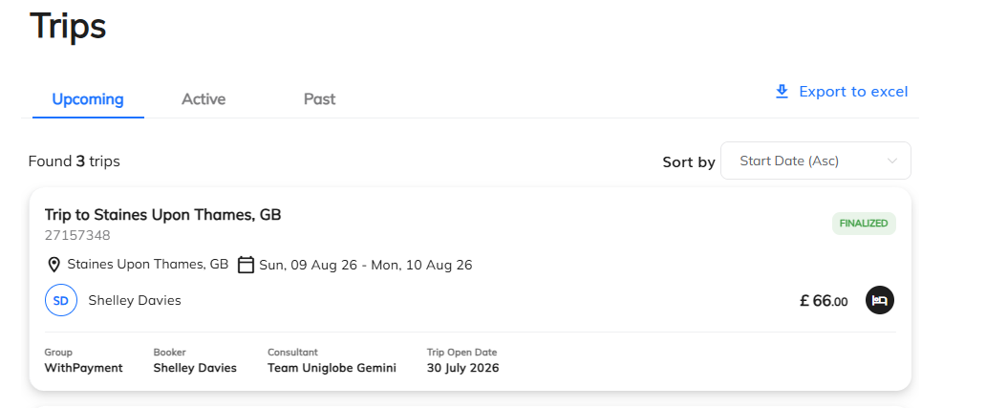
ACTION REQUIRED – (Do not ignore this email).
The booker will need to open his quote again (or follow the link on the email and click on complete booking), and proceed to the checkout with the same quote.
If in the meantime, the quote has expired, the user can use the research functionality to have access to live availability and prices, and will then need to add the flights to the cart, and checkout.
Please note that in case the booker is also the approver, we will skip the approval process and automatically approve the trip.
A trip is not confirmed until you have received your full Uniglobe itinerary and the status of the trip changes to finalized in green in the Trips section.
xxxxxxxxxxxx
Complete booking
CHECK YOUR ITINERARY CAREFULLY ONCE THE BOOKING IS APPROVED AND BOOKED TO ENSURE YOU HAVE REBOOKED ALL PRODUCTS CORRECTLY.

Slide 18
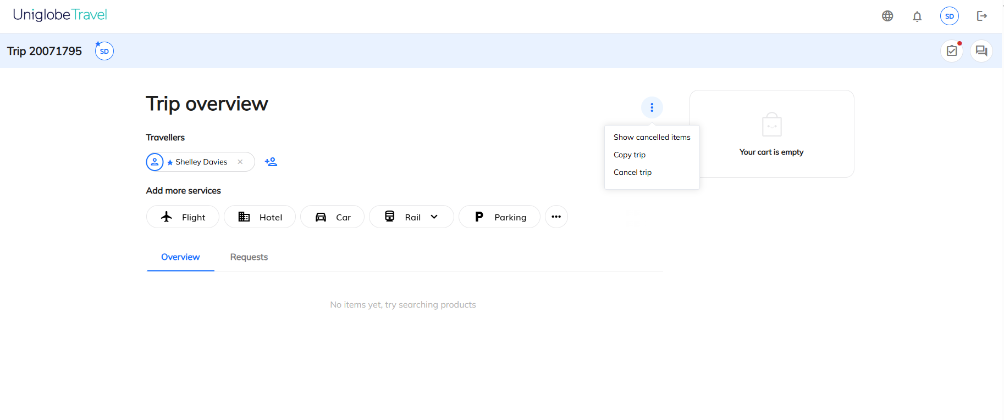
How to finalise your booking once it's been approved:
Once your trip is approved , Your action is required to complete the booking. Please note approval does not automatically finalise a booking. You MUST now follow these steps to complete your booking.
THIS MUST BE DONE IN THE SAME TRIP NUMBER
If your trip has been approved, please follow the instructions below:
It is possible items cannot be confirmed due to changes in prices or availability, then you will need to search again.
It is also possible items price has already expired.
Recall the approved trip number, Click the three dots top right then select Show cancelled items.
To research hotels:
Click hotel tab, research hotel, click view rates, click add to trip, tick the terms and conditions box and click proceed to check out - click book and finalize
This MUST be in the same trip number.
Click the three dots top right then select Show cancelled items
To research flights:
Click check price, a price check box will appear , click proceed to add to cart, tick the terms and conditions box and click proceed to check out - click book and finalize
This MUST be in the same trip number.

Slide 19
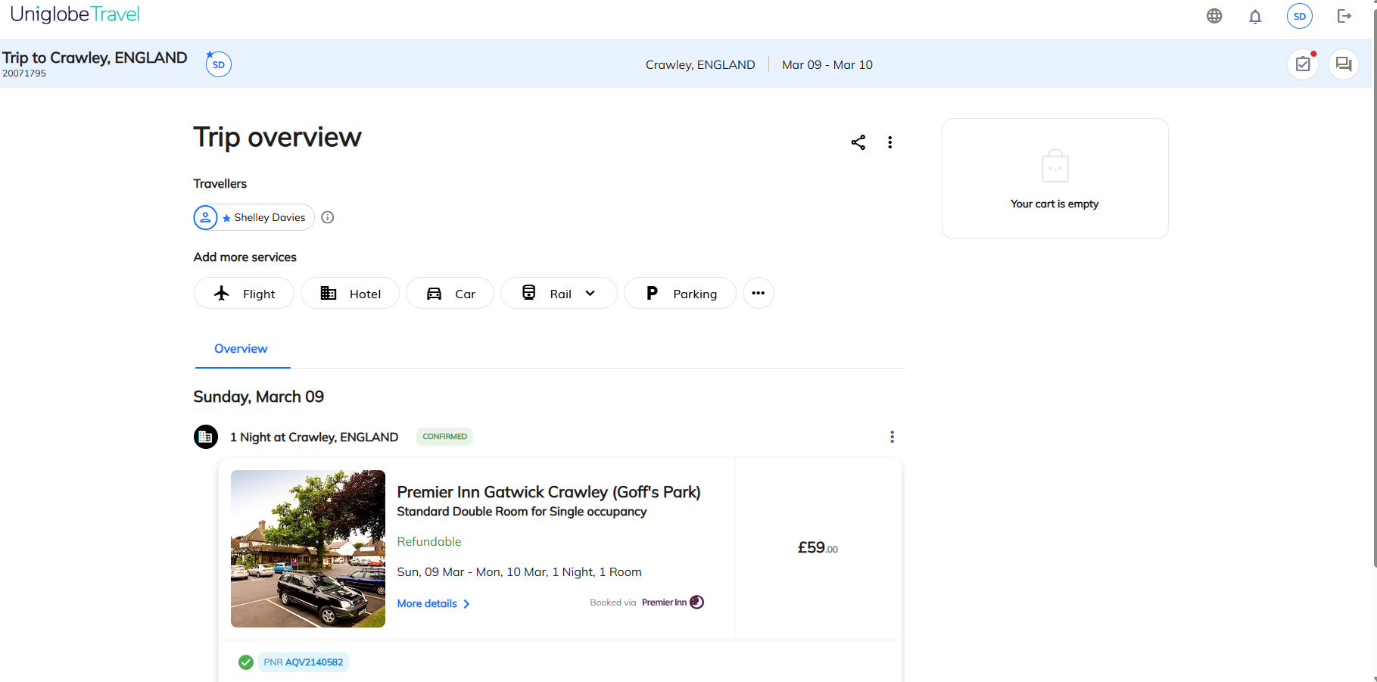
Booking Confirmed.
To ensure your booking is complete. click into the booking and all elements will show a green ticketed/confirmed and will have a supplier reference.
Green confirmed icon.
Supplier reference number

Slide 20

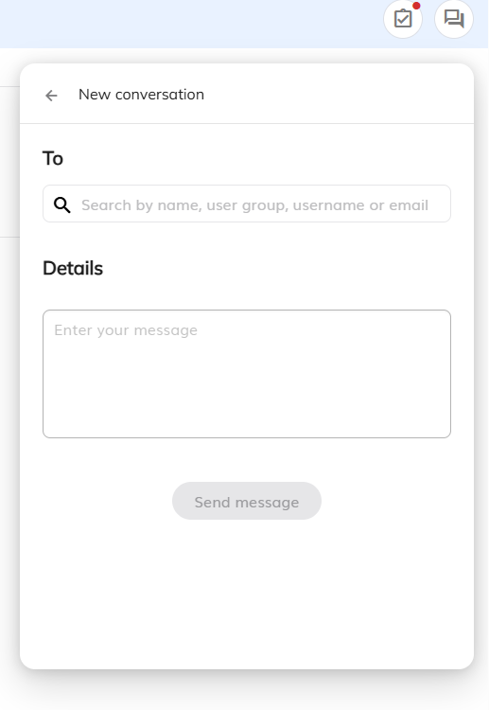
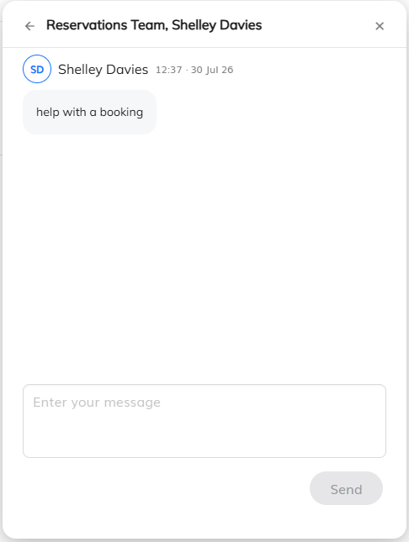
Add email address in the “To” box then add comments to the “Details” box and send message. This will open a chat thread.
Trip Conversations
Please note, chats will be handled during normal office hours (Monday to Friday 0900 – 1700) and will incur offline booking fees.
How to Use the Chat Feature
Follow these steps to chat with an agent directly inside your booking window:
Open the Booking: Navigate to your active trip itinerary or pending booking request.
Launch the Chat: Click the Chat icon located in the sidebar or directly within the trip details panel.
Type Your Message: Enter your question regarding flights, hotels, car rentals, or policy approvals.
Send the Request: Click the Send button to instantly alert the travel support team.
Track the Thread: Keep the window open or return later; your full chat history stays saved inside that specific booking.

Slide 21
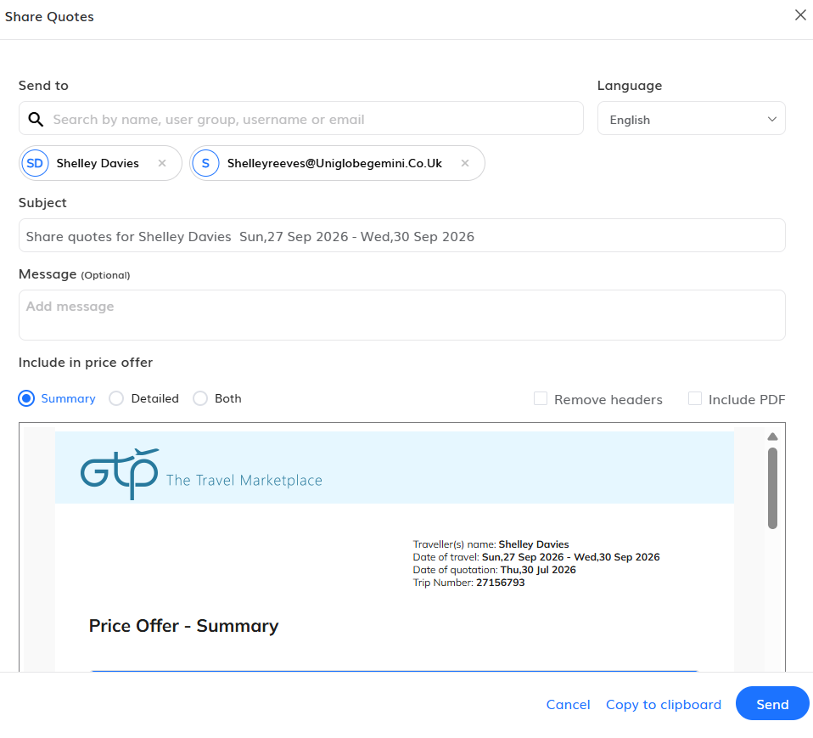
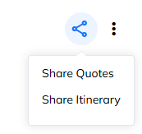
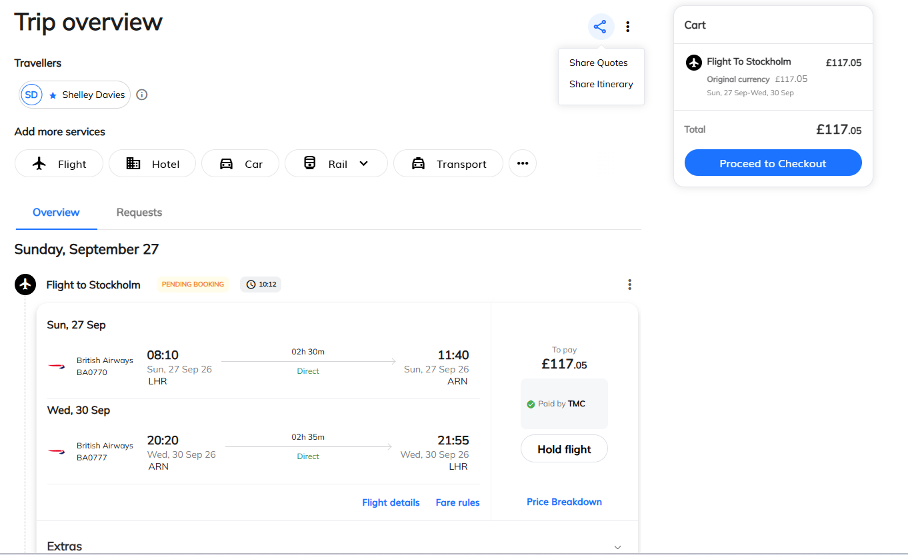
Select what elements and who you wish to send the quote to.
Email Quotes
You can email quotes from the search results pages.
Click here and the following box will open
This is the preview to the quote summary you are sharing.
Please note you can email quotes for all products.

Slide 22
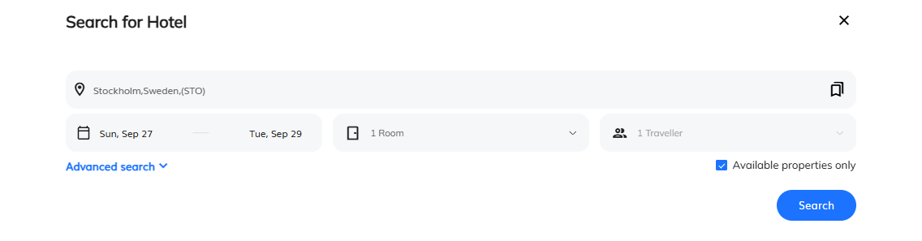
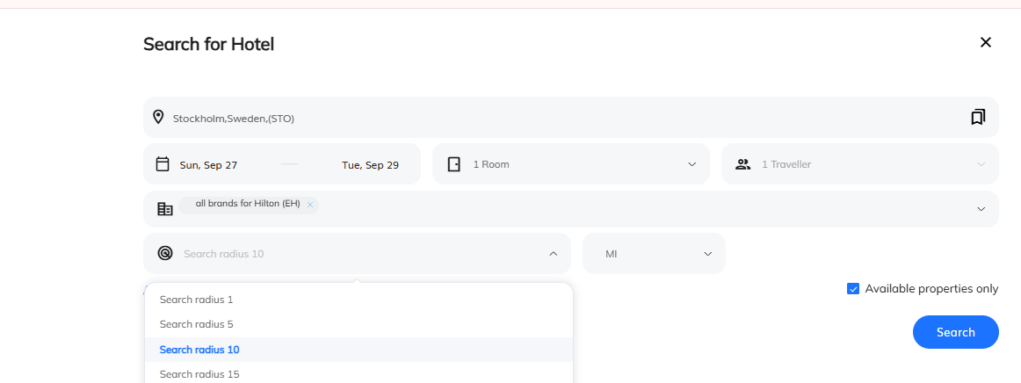
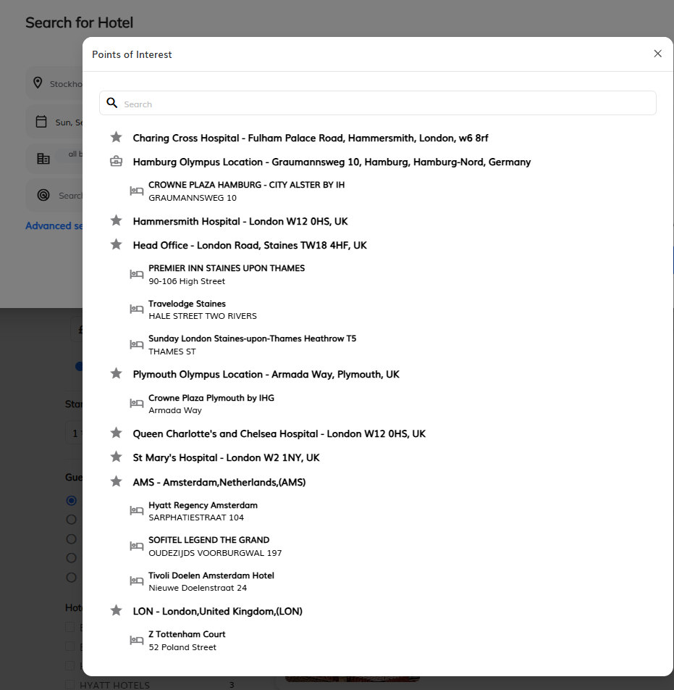
Hotels
For your convenience, your preferred hotels are retrieved first. A complete list of properties will be available in a few seconds.
Complete search
You can search for hotels by specific name, address or around an official landmark.
The system will offer a list of frequent locations (Points of interest).

Slide 23
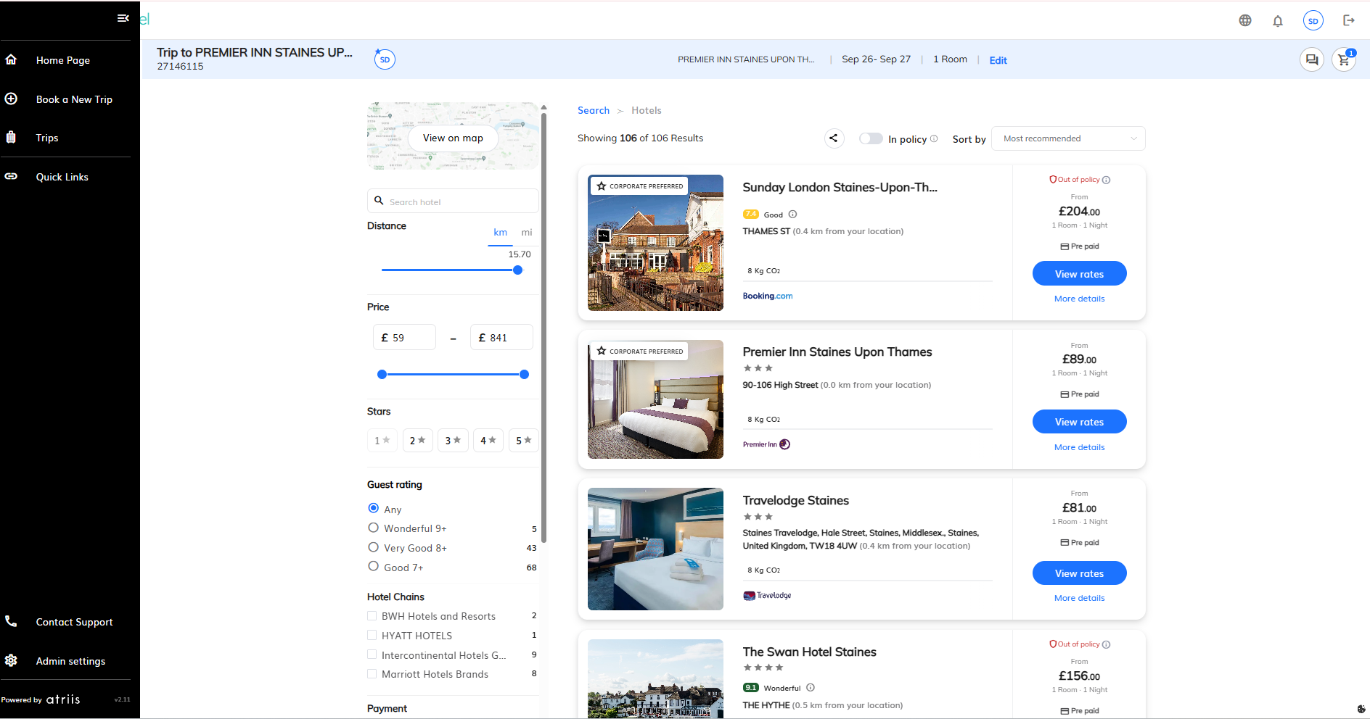
Hotels
Your company preferred hotels are retrieved first.
Google Maps are fully integrated.
Search the map for a specific address.
Select “View rates” to book the appropriate rate ie- to Include breakfast.
Open Filters to narrow the search.

Slide 24
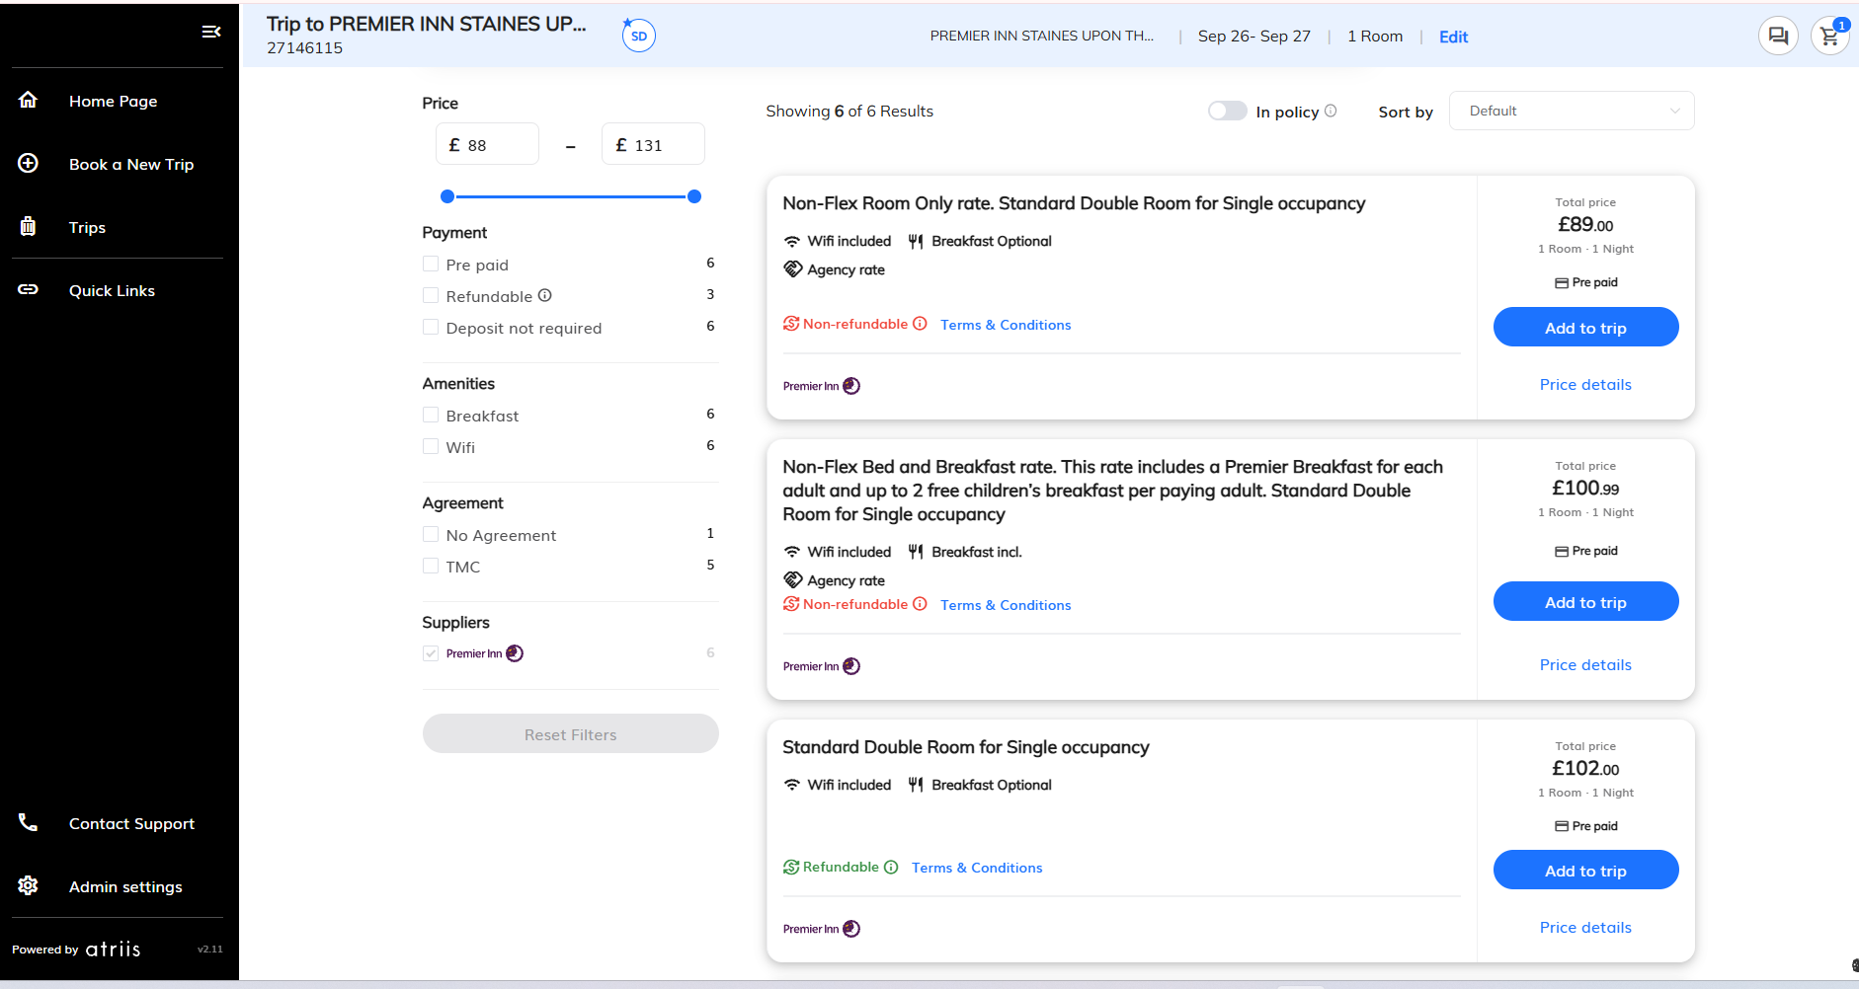
Hotels
To book ‘Add to Trip’.
All rates are pre- paid and will be invoiced to your travel account.
Cancellation Rules are found under ‘Terms & Conditions’.

Slide 25
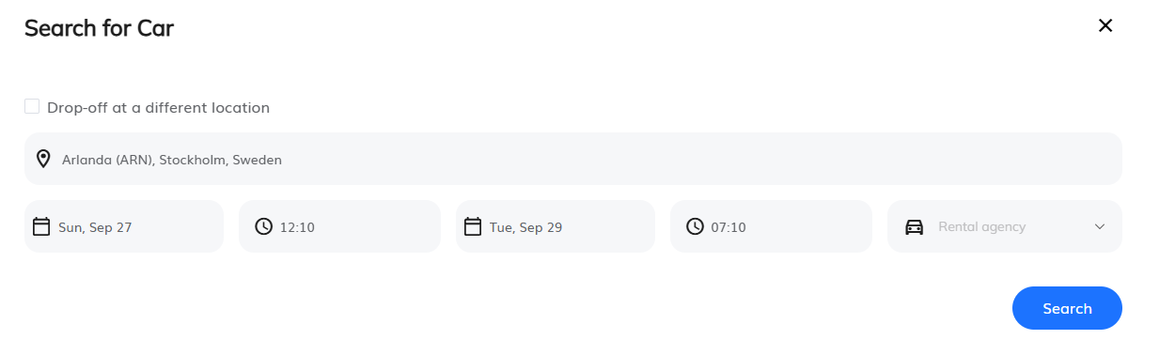
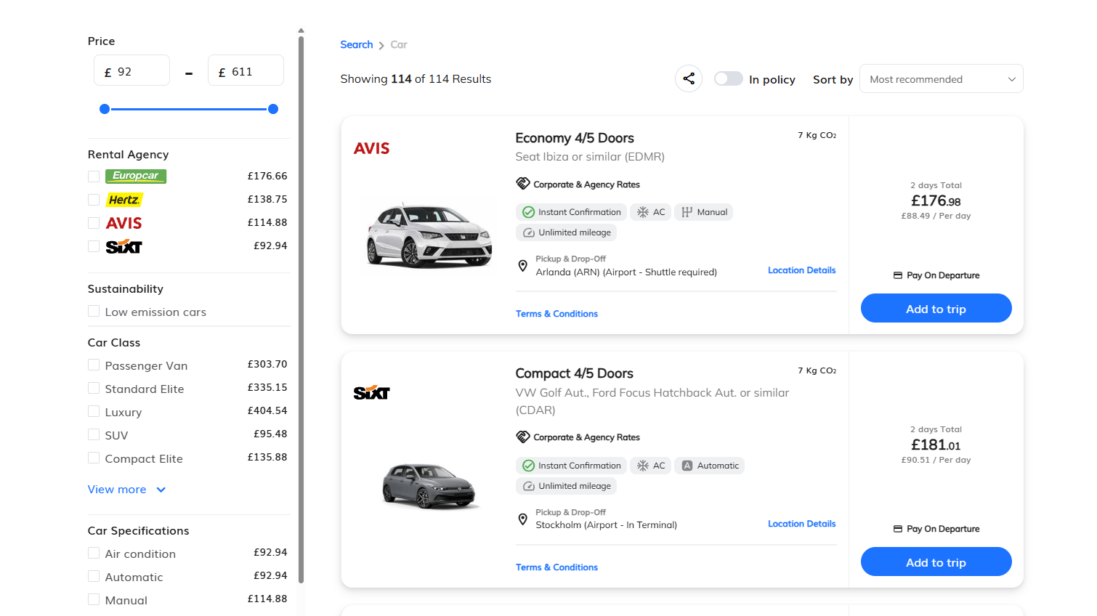
Car Hire
Please note car delivery is not
available through the system.
Complete and click ‘Search’.
Filter & Sort
To book ‘Add To Trip’
Full details of the policy are found under ‘Terms & Conditions’

Slide 26

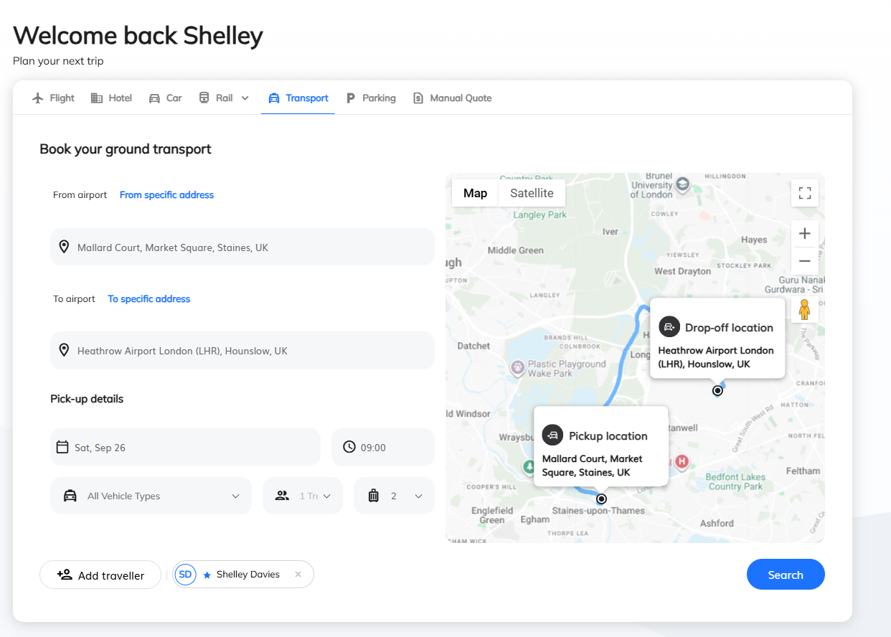
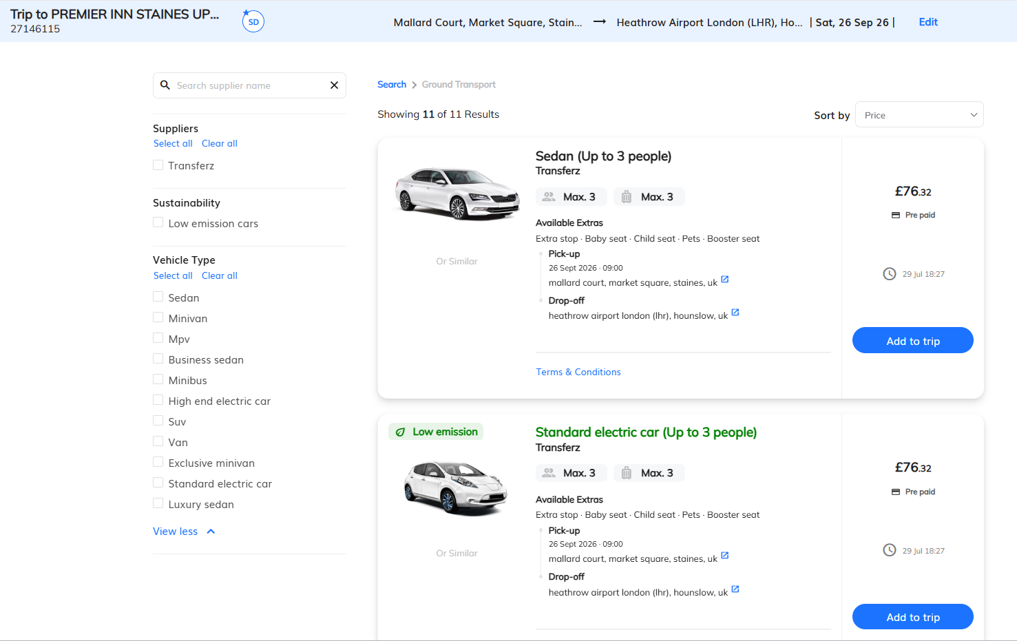
Additional Products
Ground Transport
Complete and search
Book for UK and Worldwide Transfers
Select and Add To Trip

Slide 27

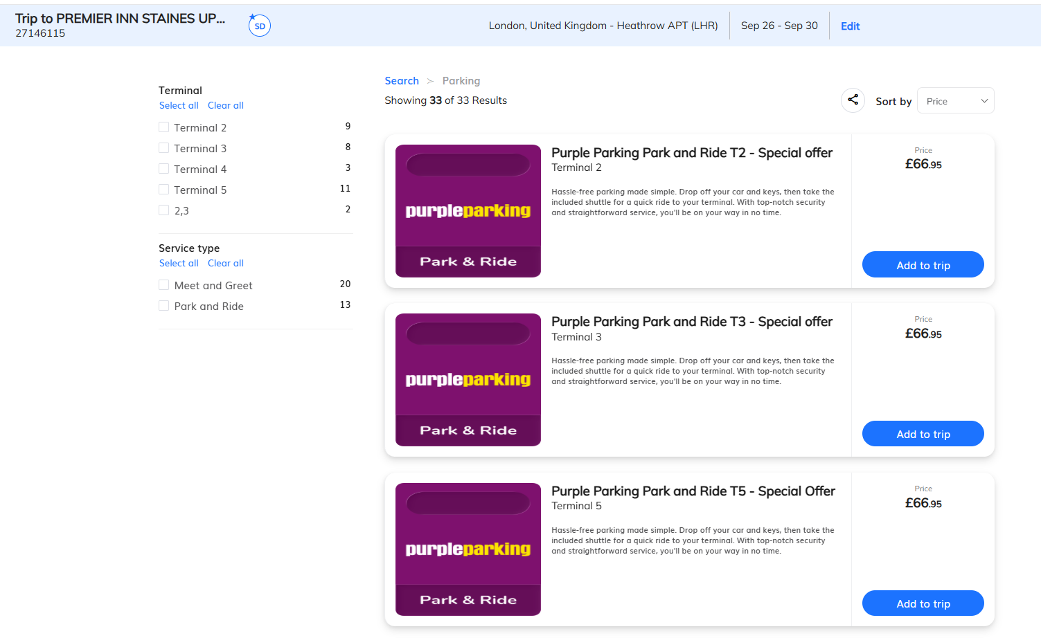
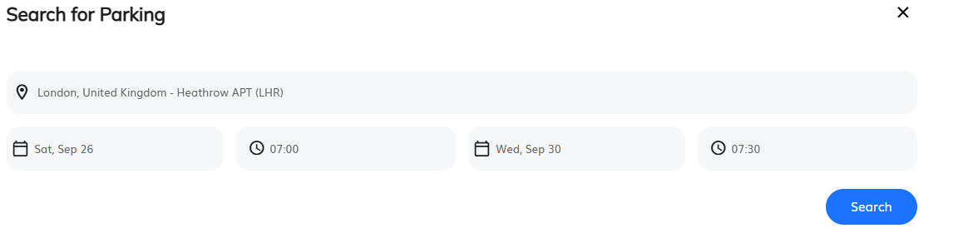
Additional Products
UK Parking
Select Terminal and choose parking option then Add To Trip
2. Select Terminal
1. Complete and ‘Search Parking’
3.Add to trip

Slide 28

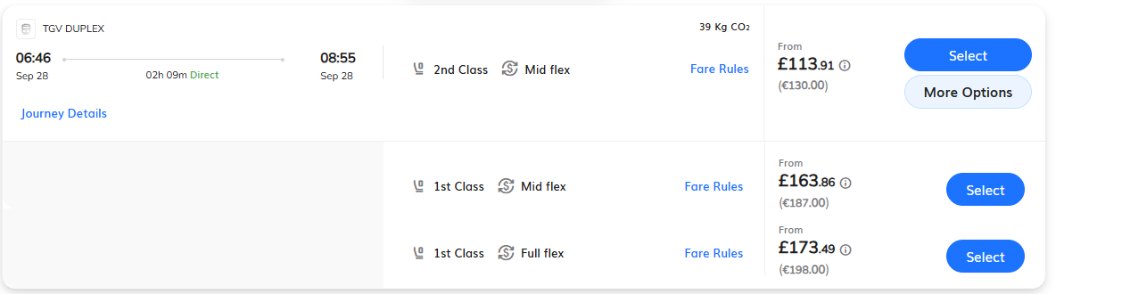
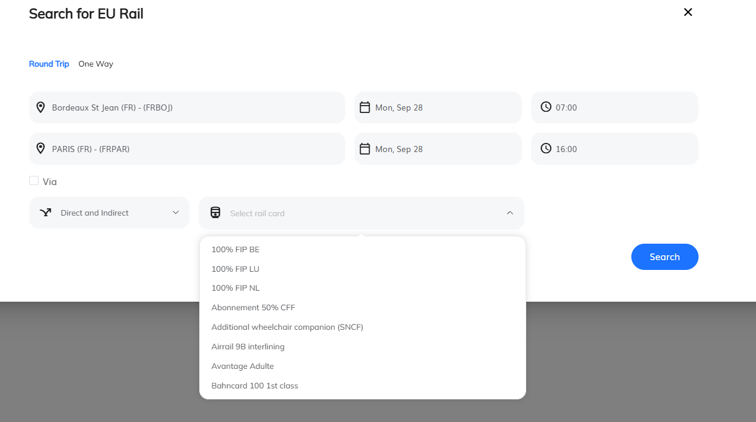
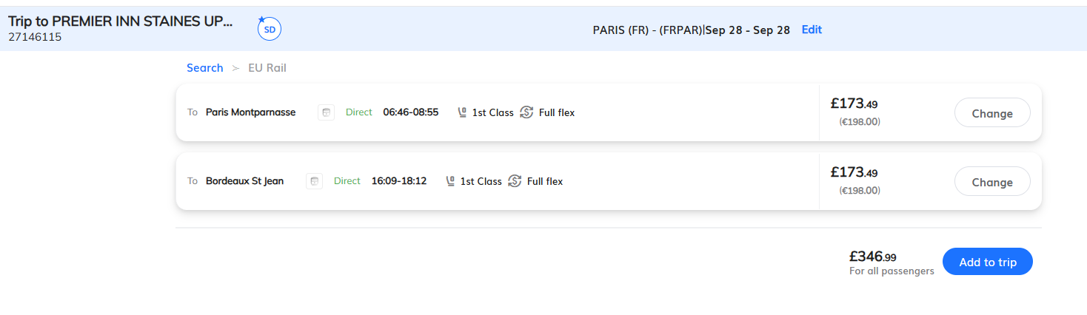
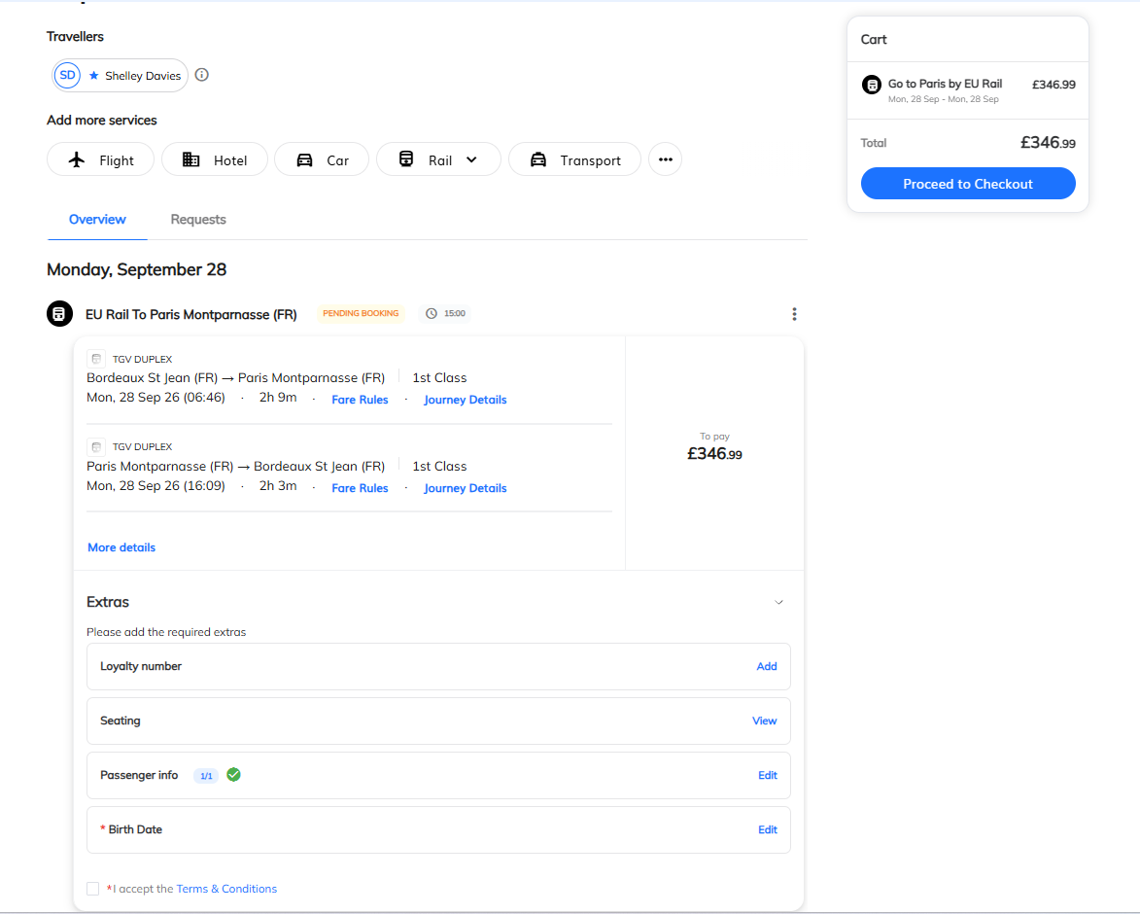
Additional Products
EU Rail
Check for additional fares
Complete search, then select ‘Get Times & Tickets’ adding any discount rail cards into the Rail Card search box.
Select fare
View Fare Rules
If required do the same for the inbound journey. Review your trip and ‘Add to Trip’ to book.
Add to trip
Add rail discount cards.
To complete trip
Select the fare to add to your basket or open ‘More options’ to see more fares and discounted fares if you have added your rail card.
View ‘Fare Rules’ buy selecting the Fare Rules button.
If fields are highlighted red they are required to complete the booking

Slide 29

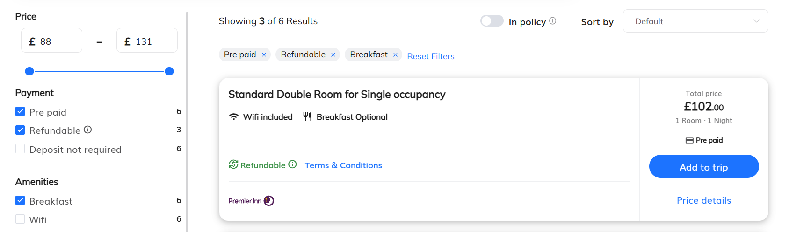
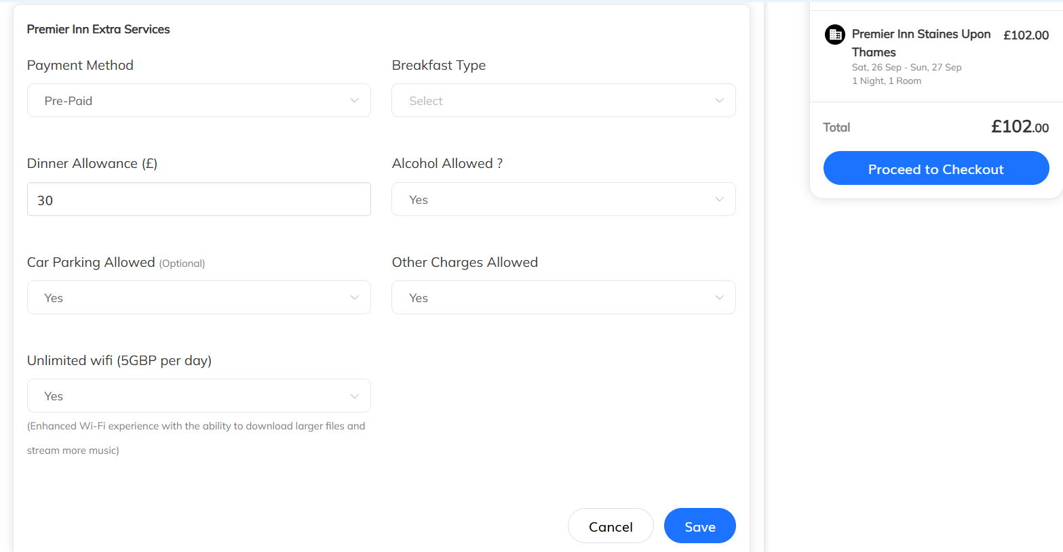
Booking Premier Inn Hotels
To ensure your hotel is prepaid use the Premier Inn direct rates.
Only book hotels using the rates.
Always select prepaid rates, otherwise, we can’t guarantee prepayment of your hotel room.
Choose a rate with breakfast or breakfast and extras can be added on at check out along with any meal allowances.
Once you are happy you have added all extras - proceed to checkout

Slide 30
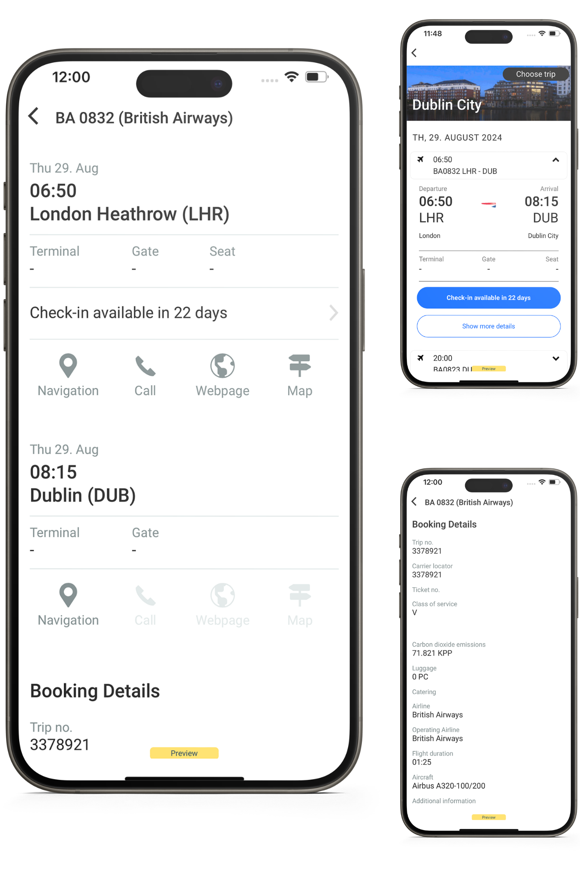
Mobile APP
Download from the APP Store, available for Android and i0S.
Our application allows you to book flights, hotels, cars and UK rail from wherever you go.
Timeline view for trips - see your entire trip in one graphic display, including past trips (up to 3 months)
Offline mode display - see all your trips, even if you're in flight mode during flight.
Embedded travel policy engine - showing you whether you trip is in or out of policy
Conversations - chat with your approver or travel agent directly from the app
Approvals - Approve trips for your employees
Profile – View or update your profile information
Pre-trip approval is not activated for mobile bookings.

Slide 31
Best Practice
URL – Make sure the company whitelists it!
Bookings – Search and book up to 5 people at a time. We recommend bookings to use one trip per traveler to allow for invoicing and possible future changes.
Passports – If the user has 2 passports, after adding the flight to the cart you can select the one you want to use in the trip cart by clicking on the APIS tab.
Copy Trip – Can be used if several travelers have the same arrangements.
Separate Tickets – The system will advise if it is cheaper to book separate tickets.
Search by Schedule – Searches for each city pair individually based on one- way fares, with final pricing at the end of the process.
Request Assistance – Offline fees will apply.
Low- Cost Airlines– You can only save to the cart for 20 minutes, after this you will have to refresh. TIP – add to your trip cart last, books your hotels first!
Trip Number- Keep all elements of your trip under 1 trip number. Even if your items have expired due to approval delays always recalculate or re-add the items in the same trip number.
Itinerary – CHECK your UNIGLOBE itinerary is correct and includes all products as soon as you receive it.
Need Help - To report a problem always advise the GTP trip number and email support@uniglobegemini.co.uk

Slide 32
💡Top Tip: Keep Everything Under One Trip Number
To keep your itinerary organised and avoid duplicate trips, always keep all travel elements (flights, hotels, rail, car hire and parking) under the same Trip Number.
Waiting for approval? If any items expire during the approval process, don't create a new trip. Simply Recalculate or re-add the expired items within the existing Trip Number.
Why it matters:
✔ Keeps your full itinerary together
✔ Prevents duplicate Trip Numbers
✔ Makes approvals and amendments easier
✔ Helps us support you more efficiently if changes are needed
🎥 Need help? Visit our Client Support page, where you'll find a range of short video demos covering this topic, other frequently asked questions, and helpful tips to get the most from Atriis.

